Slide 1


ORACLES forecasting Briefing
Weather
Briefing at 30-08-2016
Forecasting For Flight #2 on 1-09-2016

Slide 2
Weather
(1) Current conditions -- sat imagery -- IR/visible
(2) Cloud forecasts for September 1, 2, and 3.
Use forecast run initialized at 12Z on 8/29 (0Z run will not be ready).
Include UKMO forecast and others (GMAO and WRF) as desired
Boundary Layer height.
(3) Contextual information which you may want to look at but not include
500mb height history, with winds and RH -- useful to get an overall picture on the weather.
1000mb, SLP, and precip might be useful too -- where is the model forecasting convection in
the next few days.
(4) Think about using some of the lat or lon cross sections.
(5) 600mb flow.
(6) How high is the mixed biomass burning layer? Do we have DATA. Try the ascension sounding
on Wyoming (Atmospheric soundings link on the web site). 61901.

Slide 3
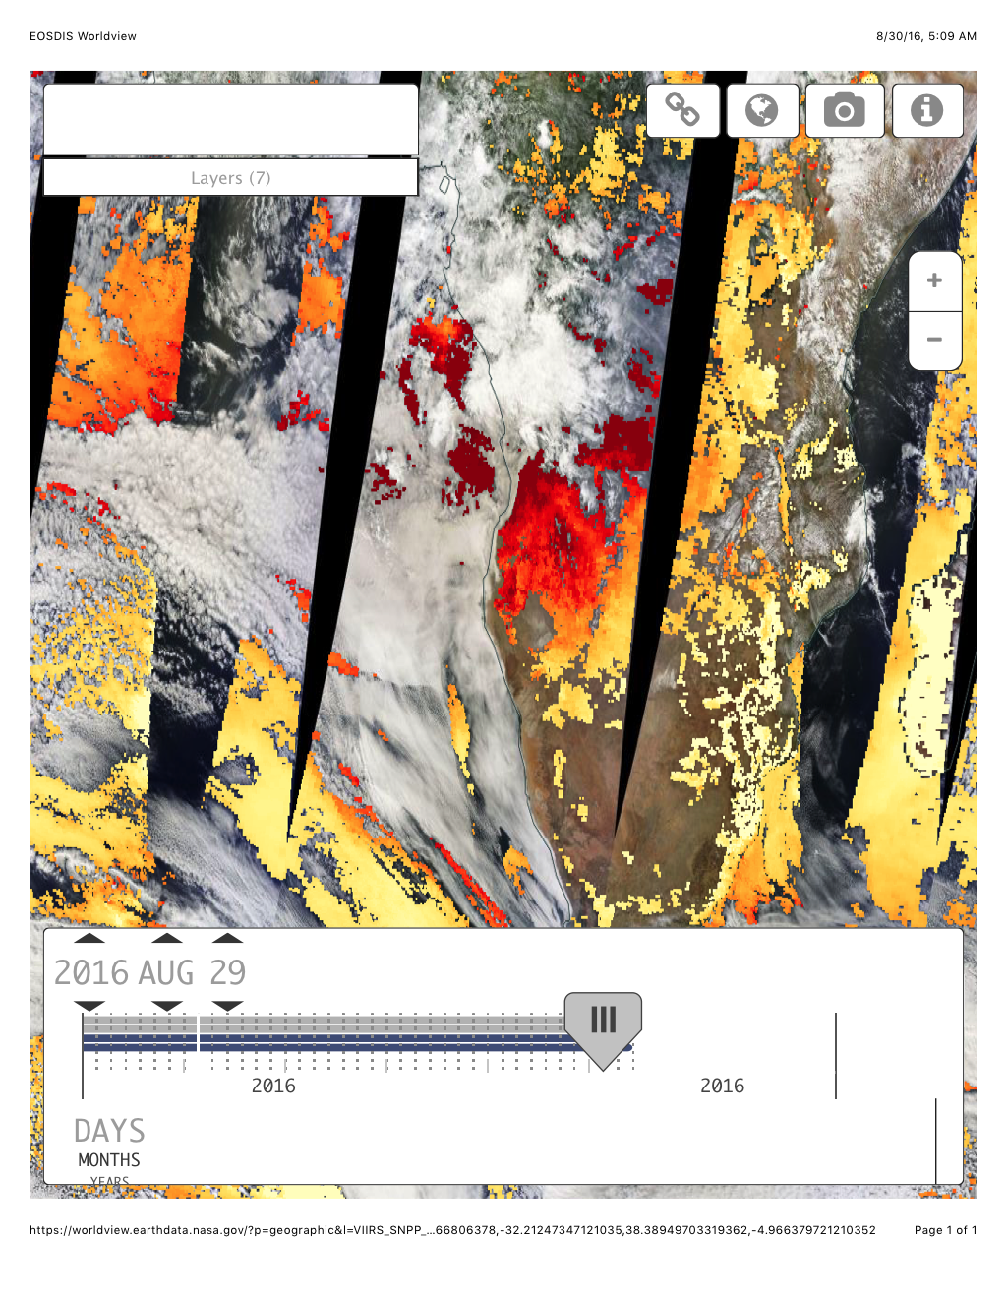
Terra MODIS, Reflectance and AOD
29/8

Slide 4
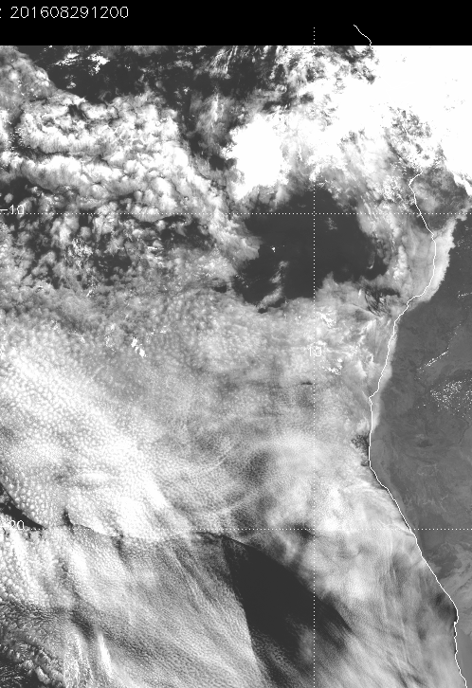
Yesterday 12 Z
IR and visible

Slide 5
This morning

Slide 6
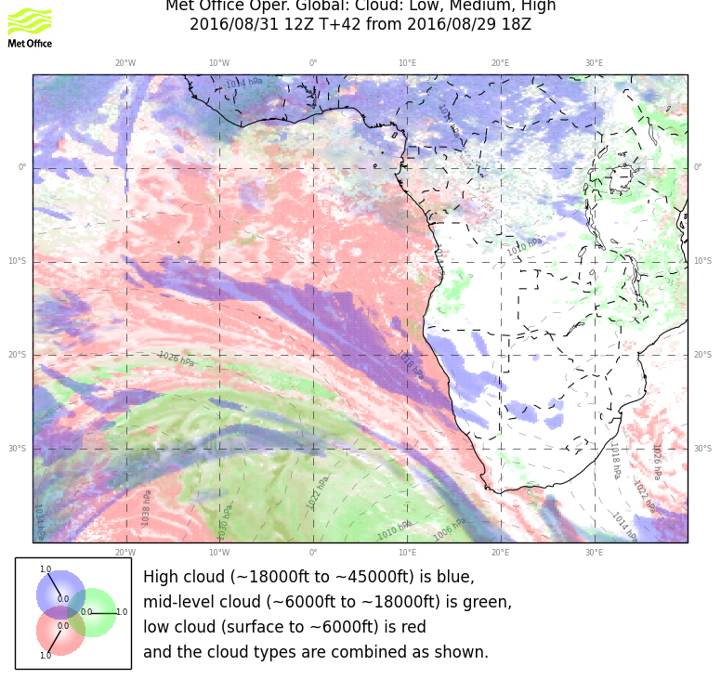
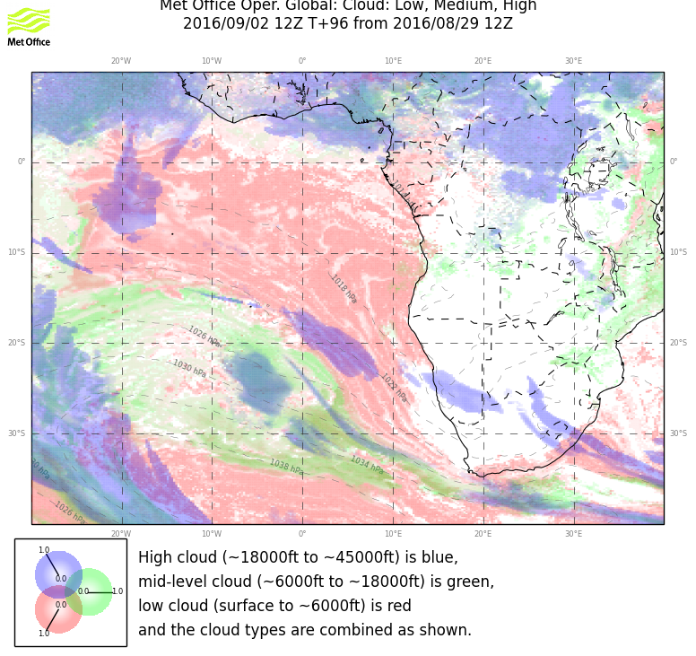
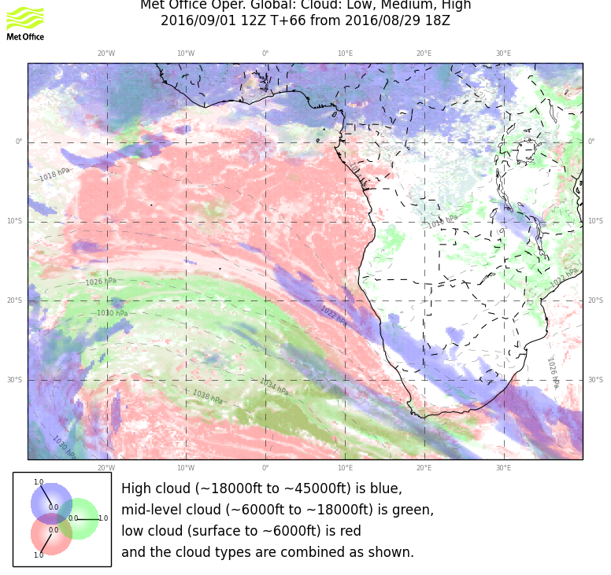
Cloud forecast
31 – 8 Wed
1 – 9 Thu
2 – 9 Fri

Slide 7
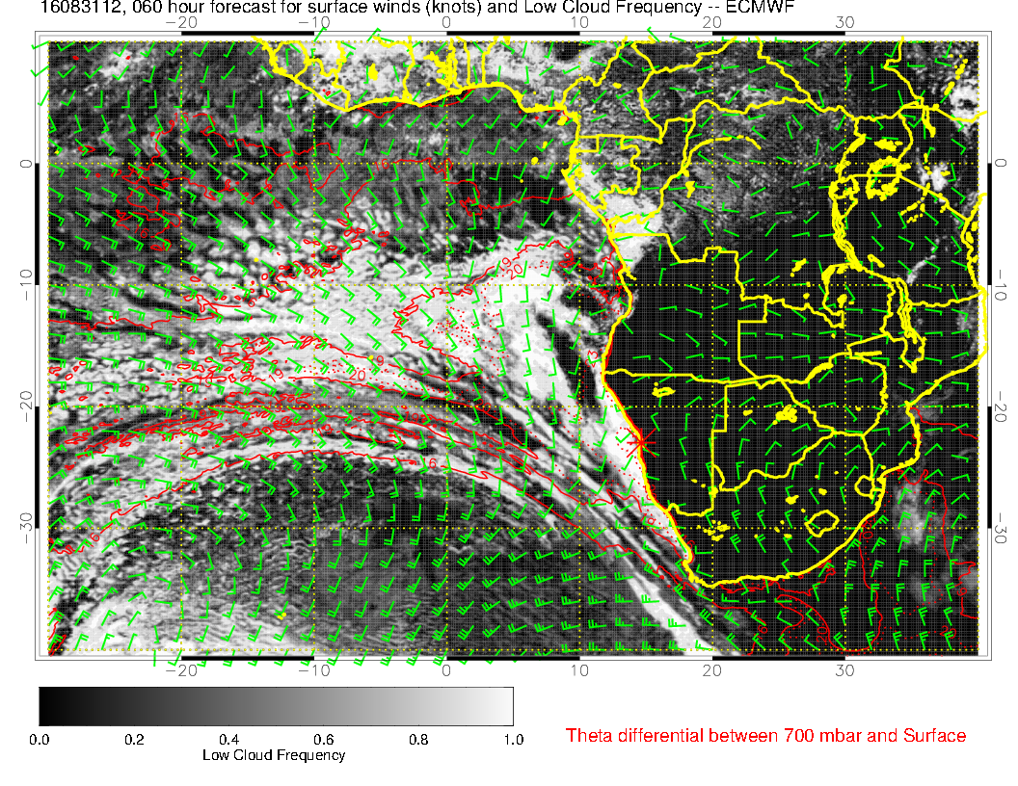
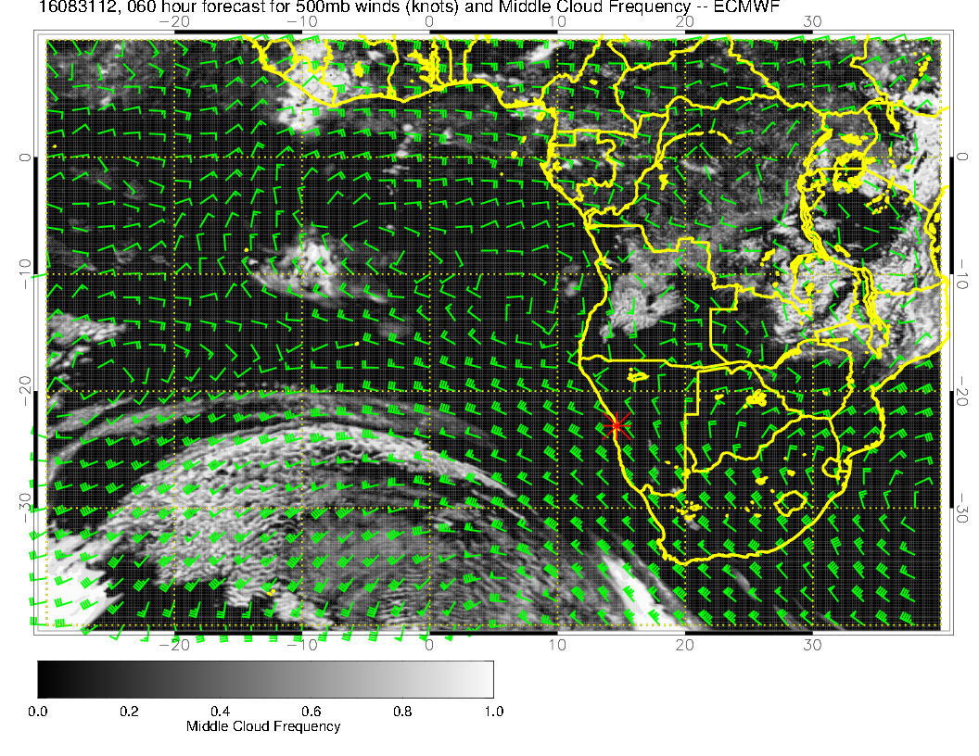
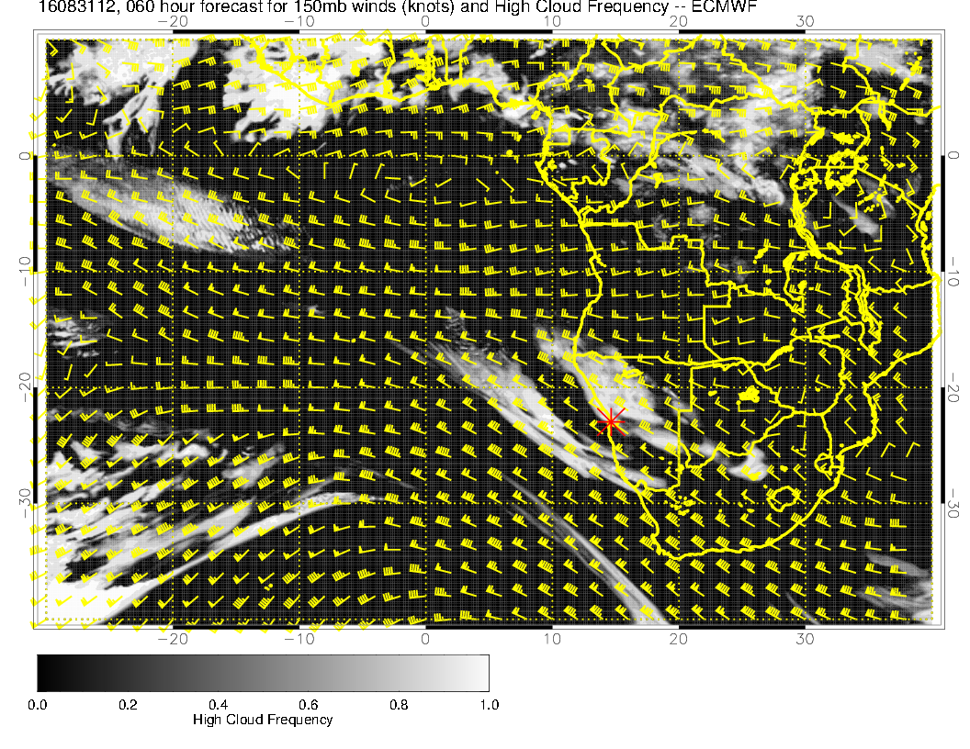
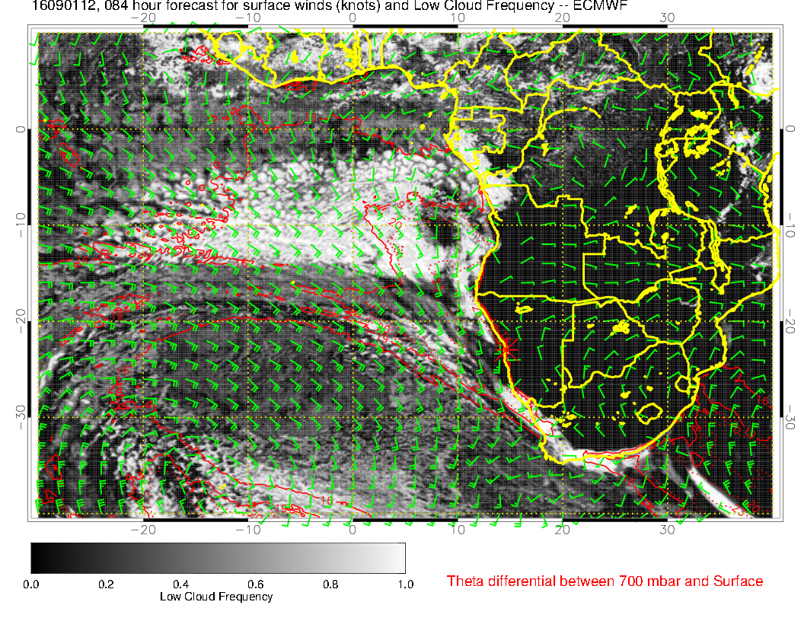
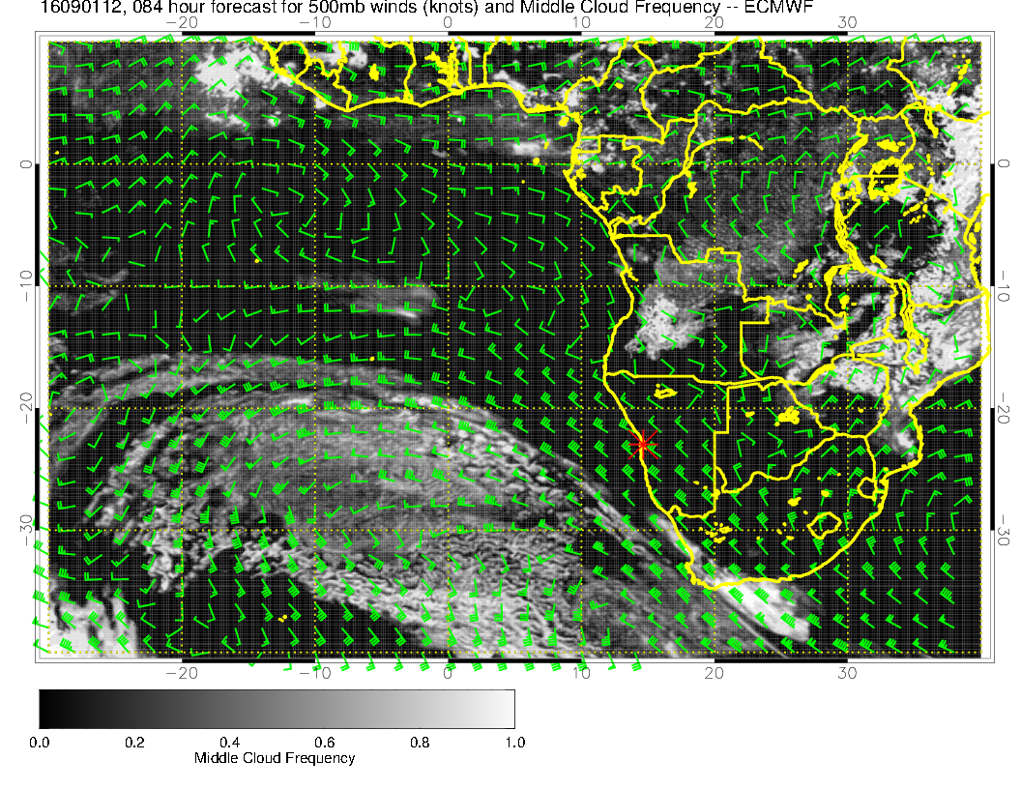
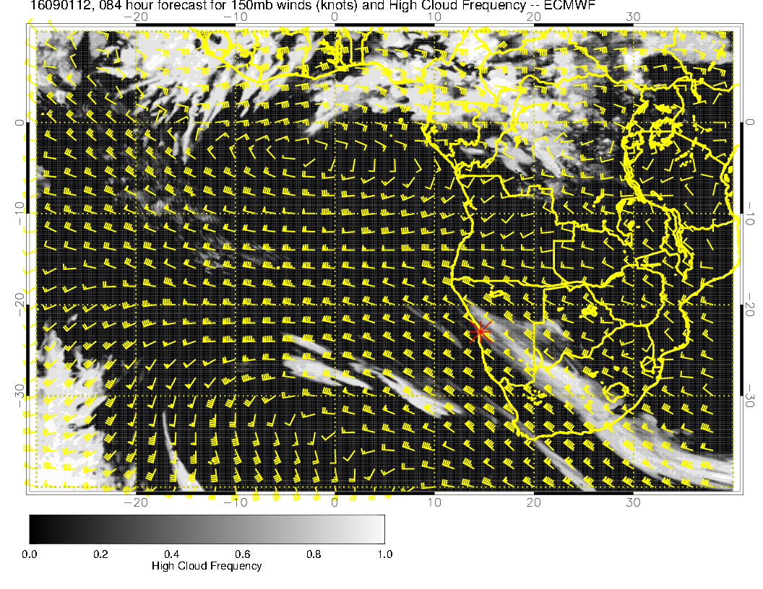
31/8 Wed
1/9 Thu

Slide 8
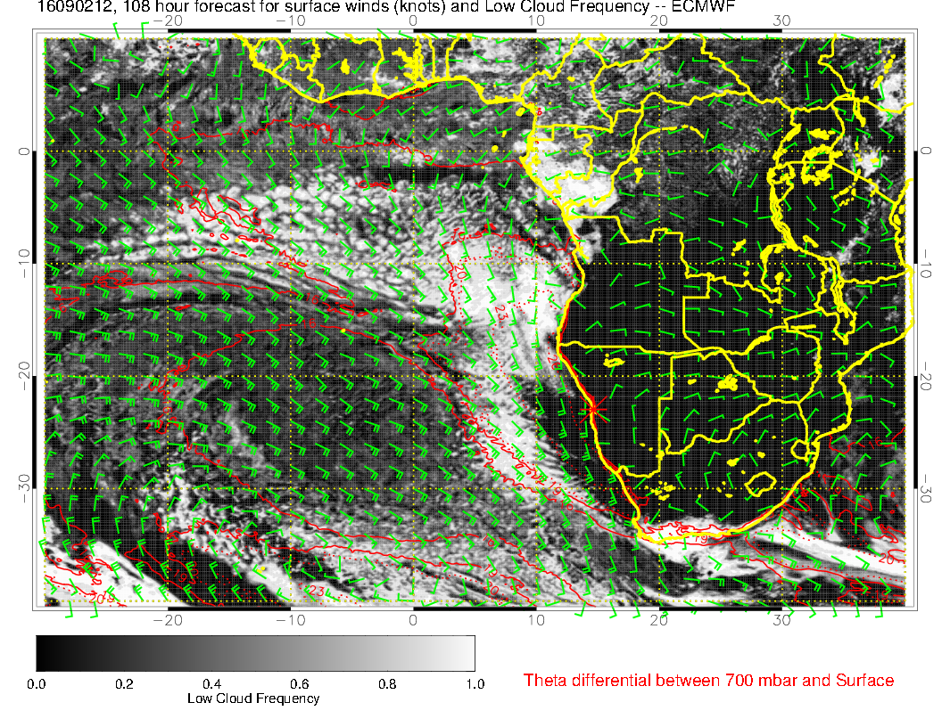
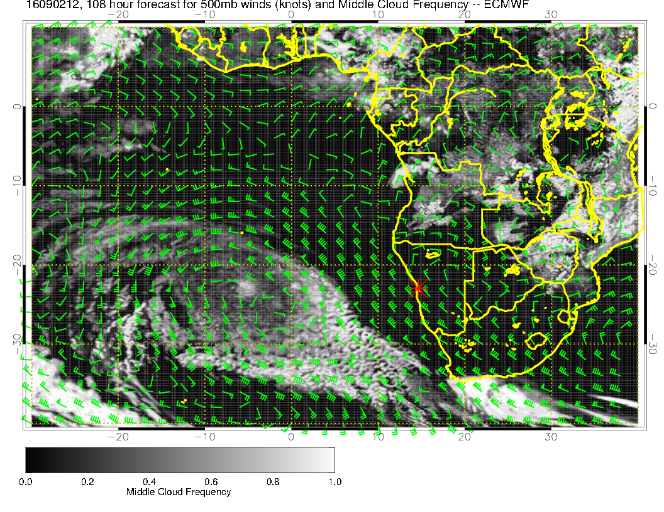
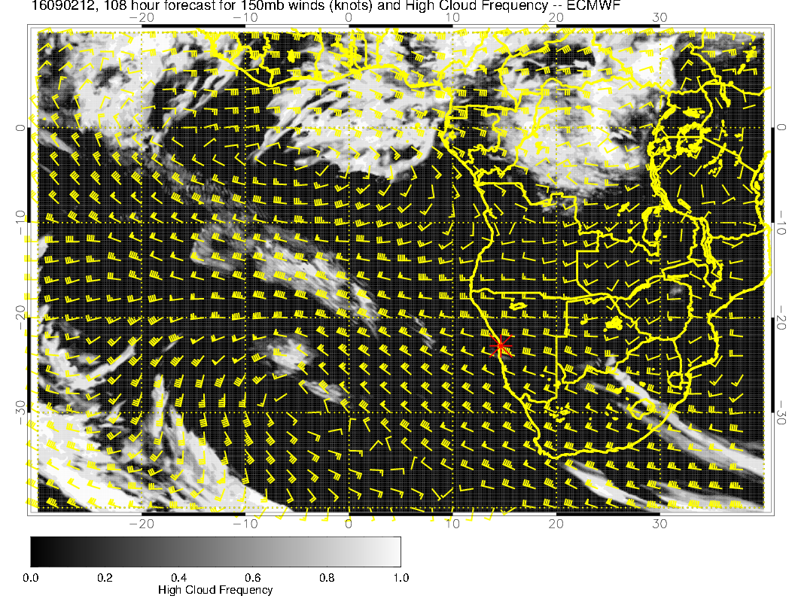
2/9 Friday

Slide 9
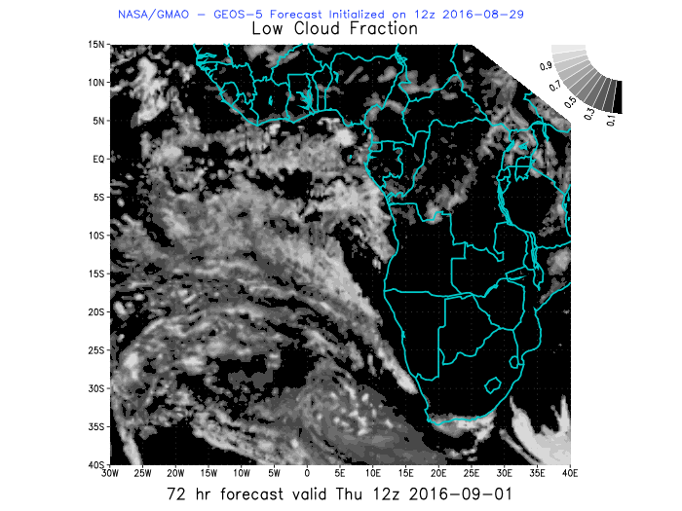
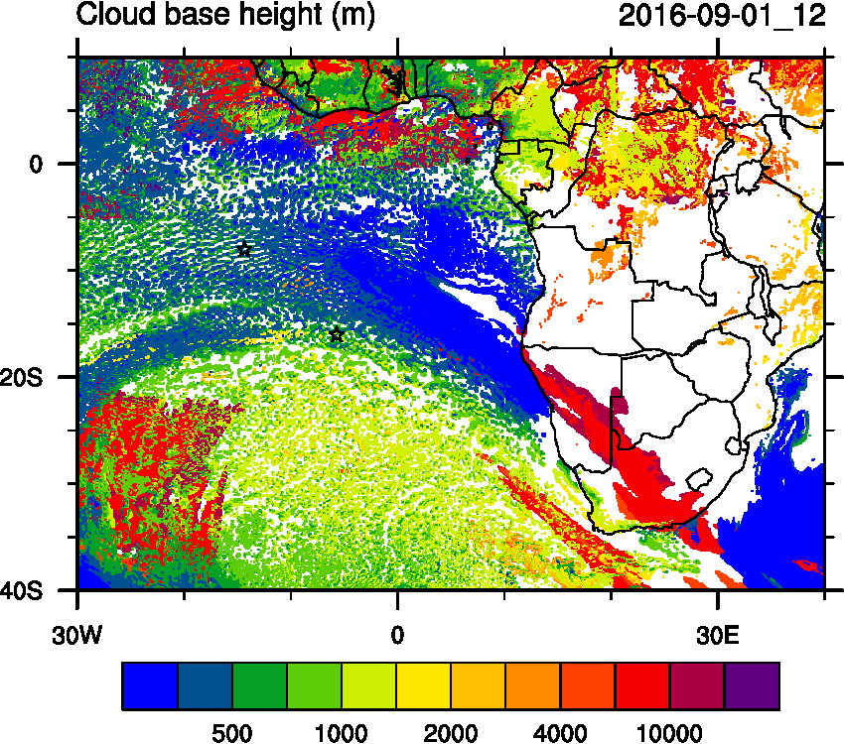
Low clouds 1/9

Slide 10
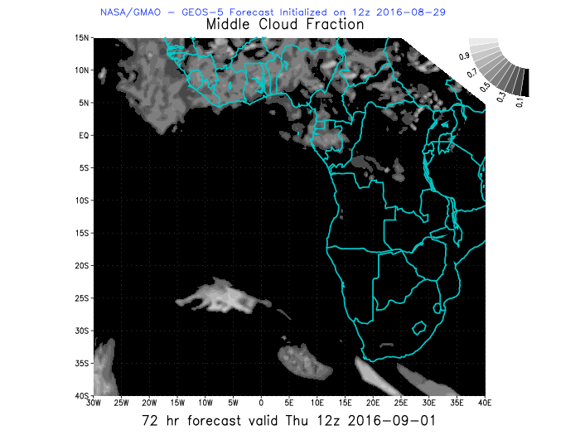
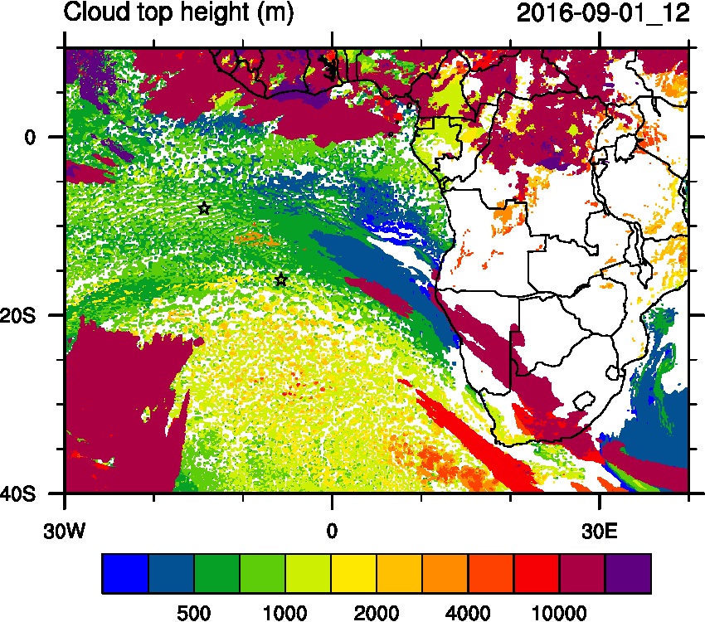
medium clouds 1/9

Slide 11
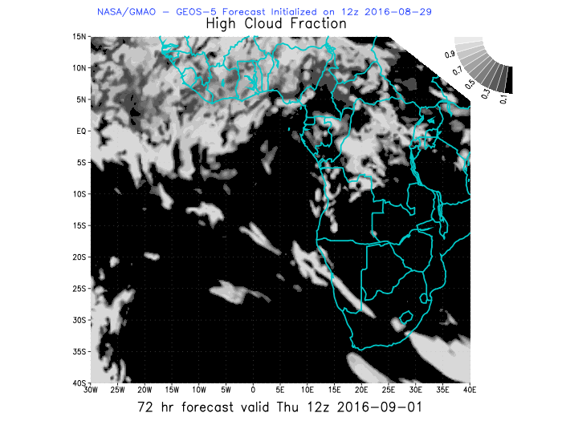
high clouds 1/9

Slide 12
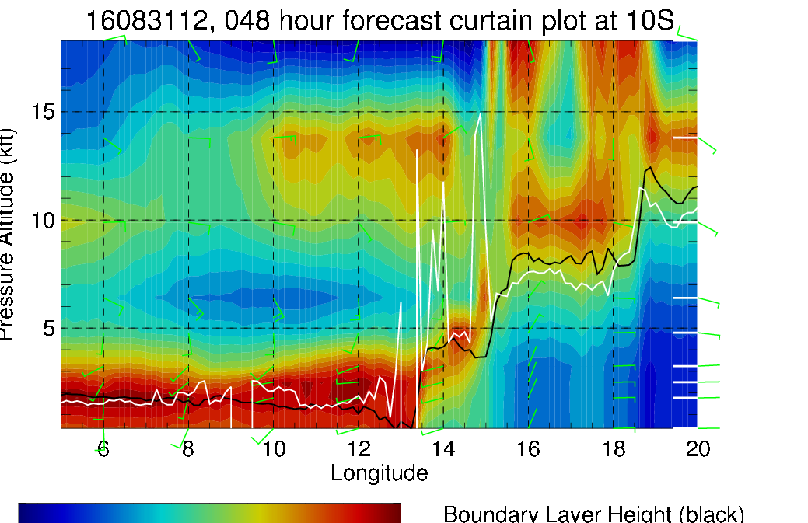
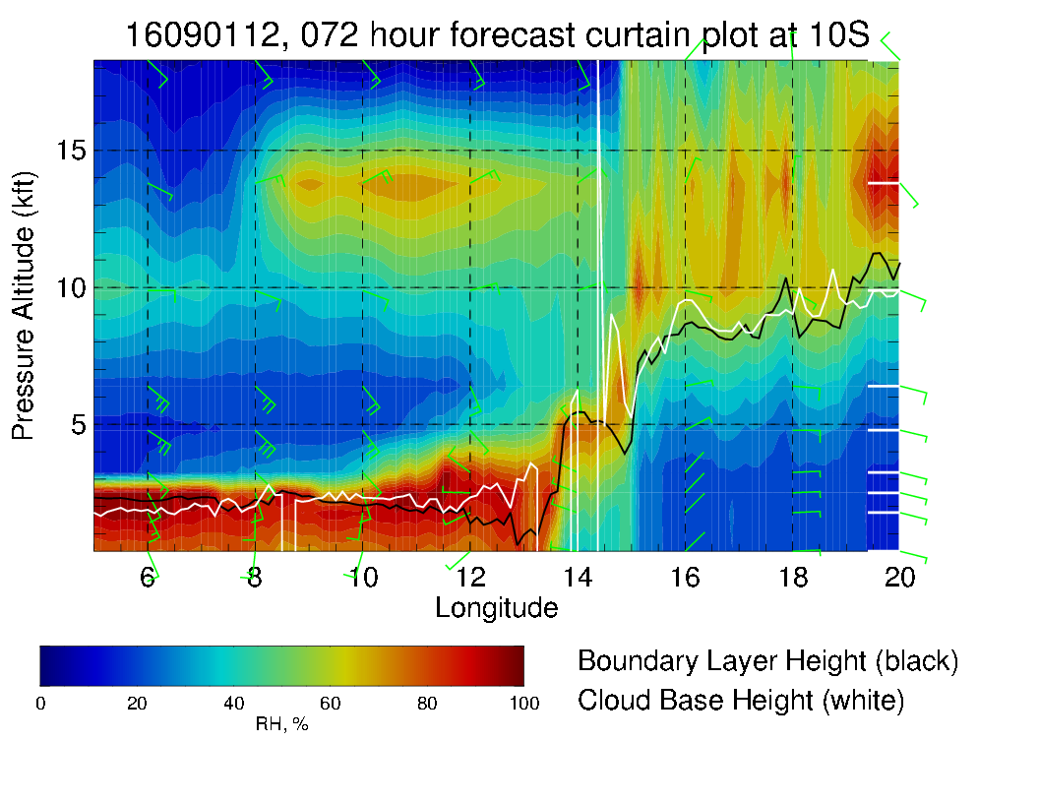
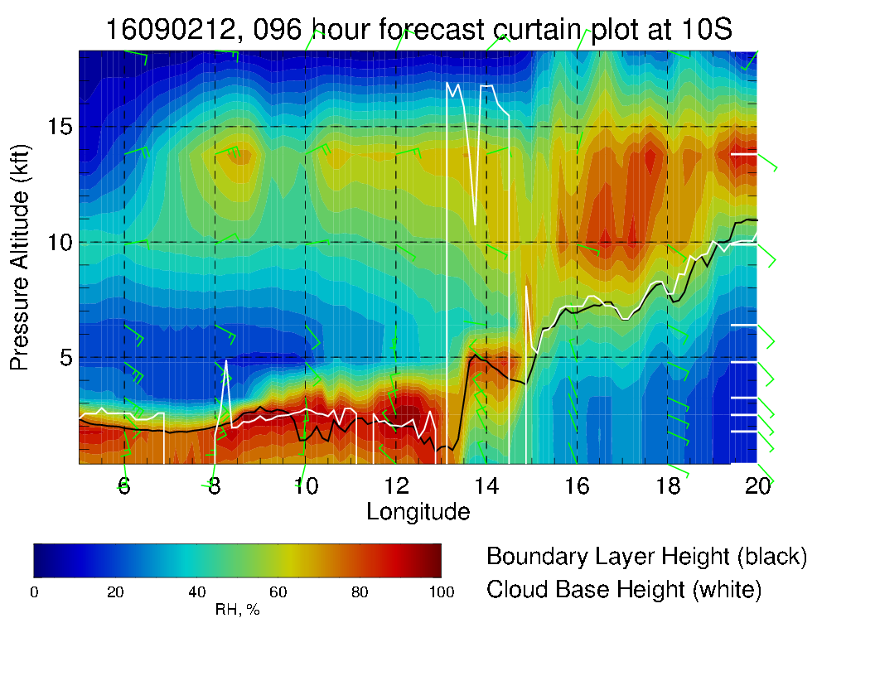
Cross sections
10 S

Slide 13
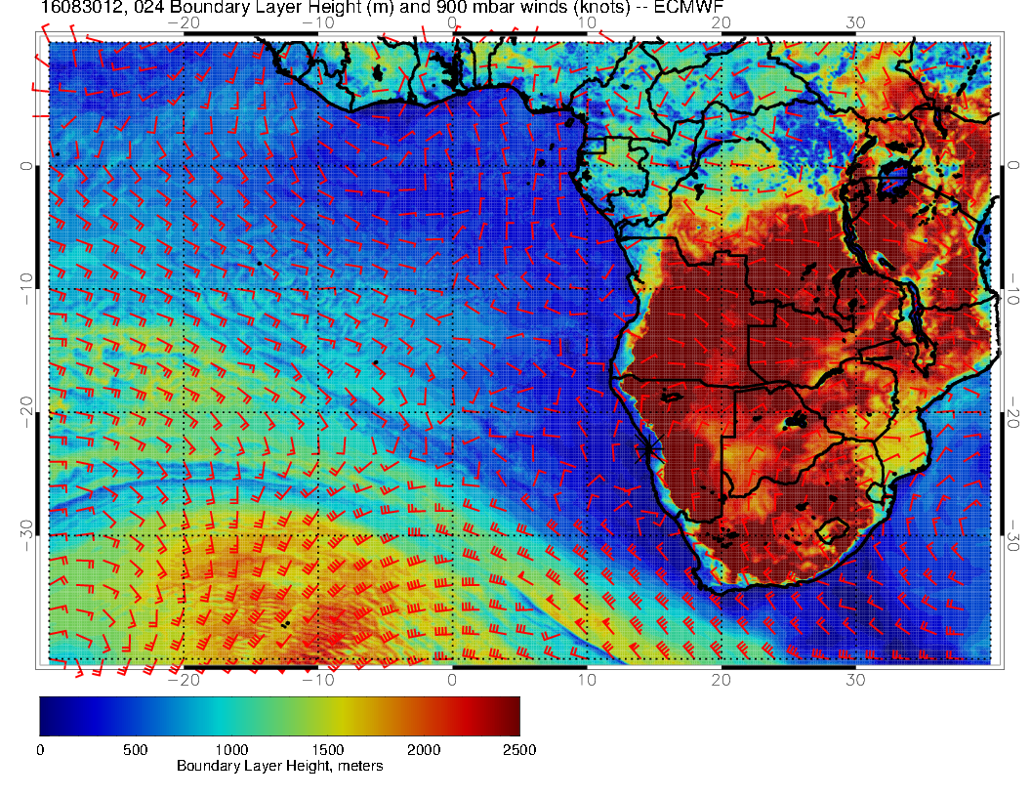
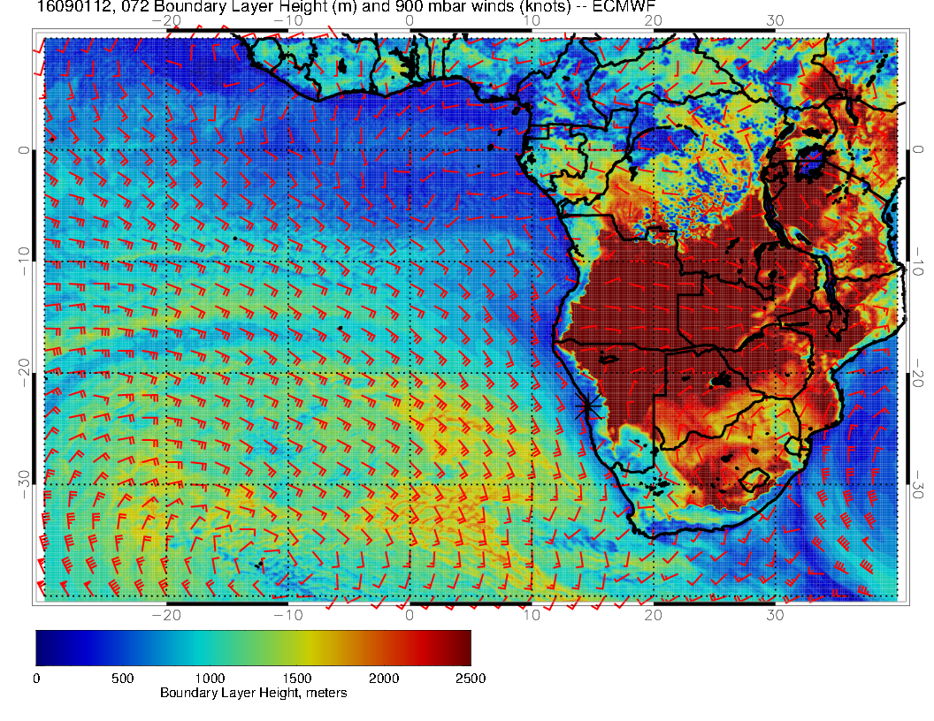
PBL (m)
Flight #1 and Flight #2

Slide 14
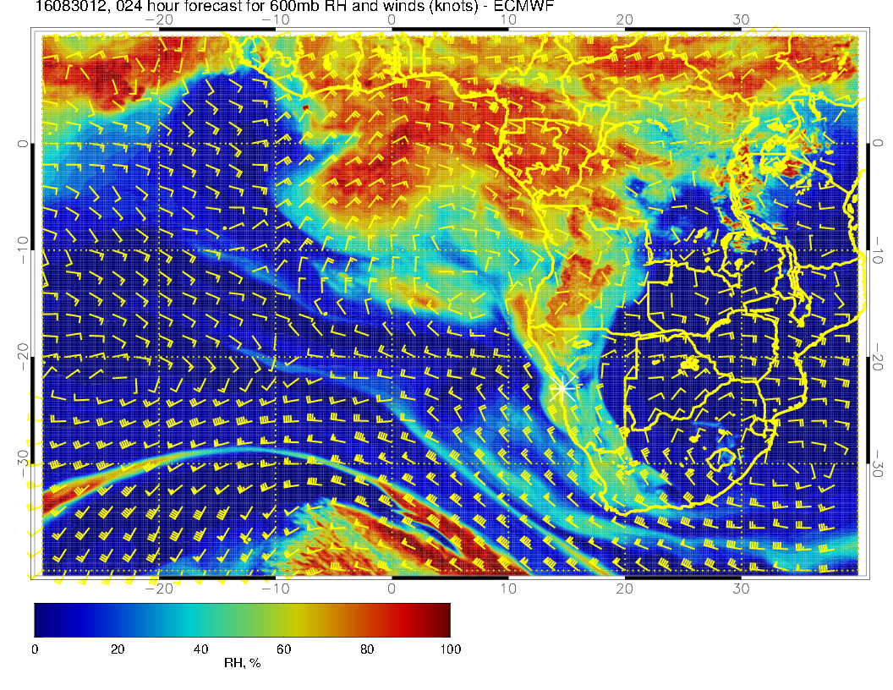
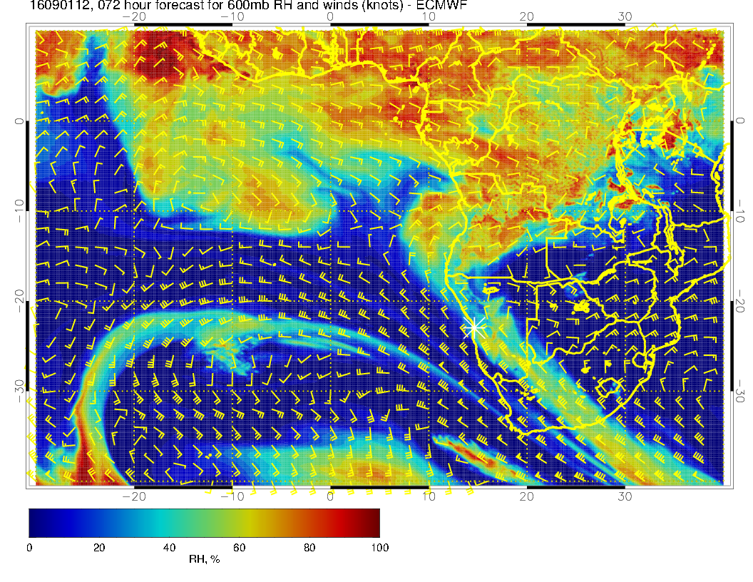
600 mb winds
Flight #1 and Flight #2

Slide 15
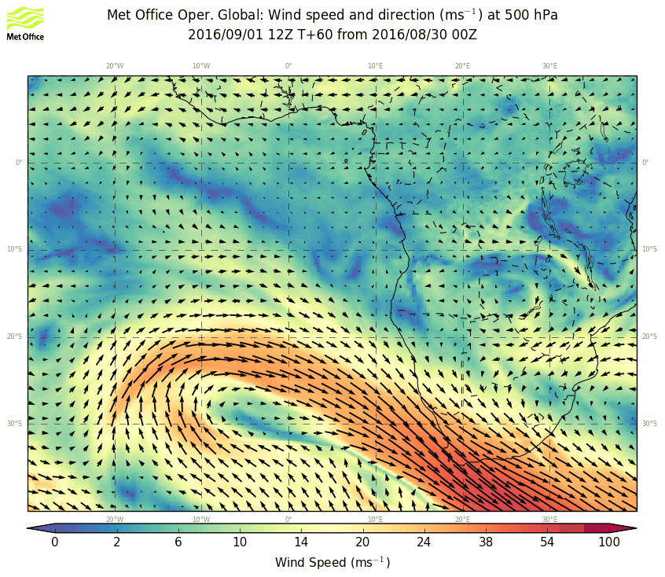
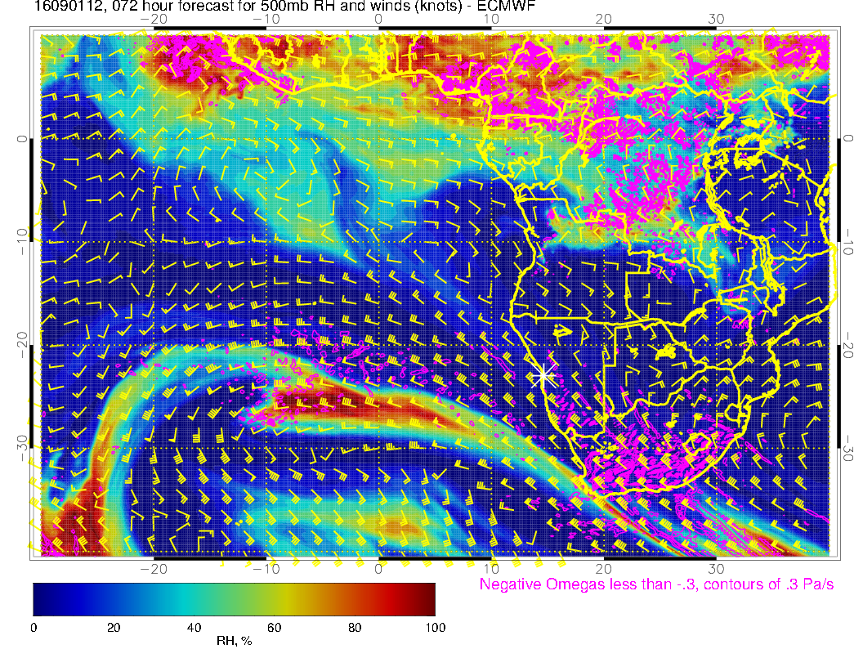
500mb winds
ECMWF and UKmet

